Slide 1
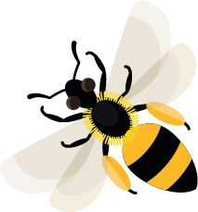
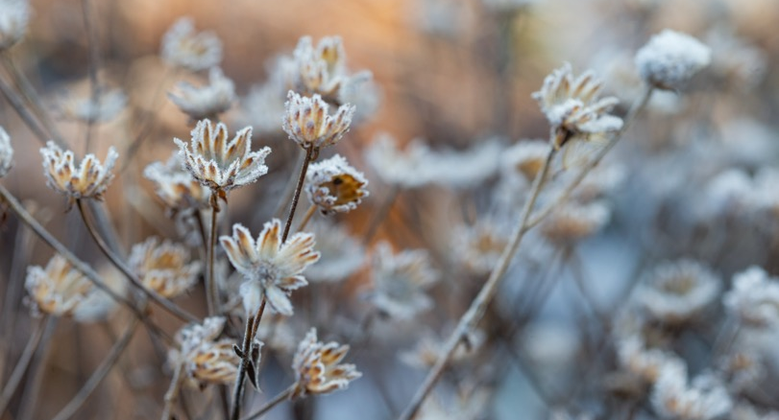
November
This month, very few bees are still flying, but you may still see
buff-tailed bumblebees feeding on nectar and carrying pollen.
Learn about: what happens to bees in winter.
Have you ever noticed that as we get closer to winter, you spot fewer bees?
To be able to fly, bees need to have warm flight muscles to flap their wings. When the weather gets colder, these muscles don’t get warm enough and flying becomes very difficult. There are also fewer flowers for bees to visit in the colder months, so finding food is much harder.

Slide 2
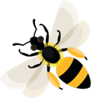
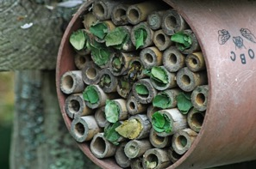
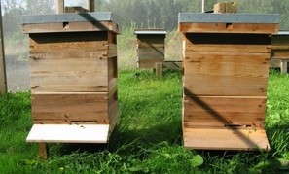
Different types of bee have different ways of coping in the winter months.
Bumblebees
Solitary bees
Honeybees
Bumblebee burrowing in ground
Leafcutter bees nesting in a bee hotel
Bee hives
Old queen bees, male and worker bumblebees do not survive the colder winter months. Only newly-hatched and mated bumblebee queens survive the winter, feeding on nectar and pollen which help to build up fat stores. After this they usually go underground into an old mouse hole, where they are protected from the cold, damp weather.
The adults will have died in the autumn. The young spend the winter as fully formed bees, tucked up inside cocoons in a variety of places. These include holes in the ground, dead trees, walls, hollow plant stems or bee hotels.
Female worker bees feed on pollen and store honey ready to stay in their hive over winter. They huddle around the queen bee to keep her warm. They also move around the hive in their cluster to stay warm and reach their honey stores. Some of these worker bees will die during the winter.

Slide 3
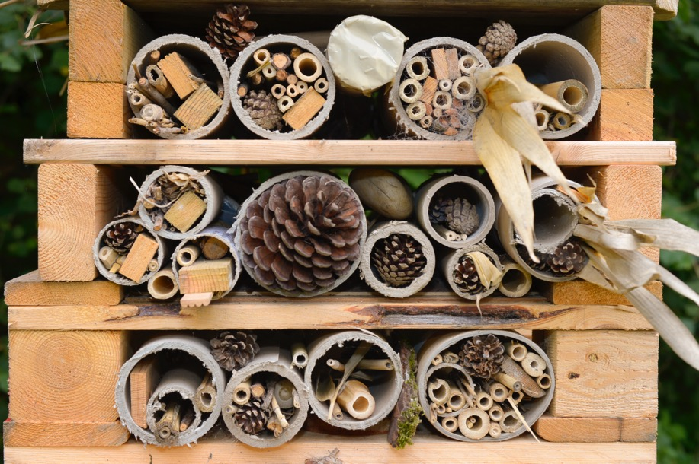
Learning activity: look for winter bee habitats
Spot places where bees might like to spend the winter. They might be old mouse holes, bee hotels, hollow plant stems, dead trees or holes in the cement in an outside wall. How many can you find?
A bug and bee hotel
A hibernation house for a bumblebee

Slide 4
Mated When a queen bumblebee has partnered with a male bumblebee to breed.
Home |

Slide 5
Nectar Sweet liquid, produced in flowers.
Home |

Slide 6
Pollen Dust-like grains, produced by the male parts of the flower.
Home |

Slide 7
Queen A single female bee in a colony that can produce young bees which are usually looked after by other female worker bees.
Home |

