Slide 1
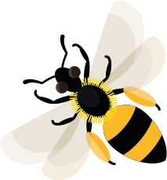
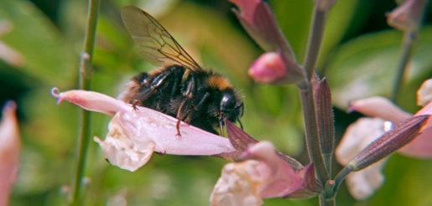
May
This month, leafcutter bees are cutting small pieces of leaf to make nests for their young.
Learn about: why different flowers attract different types of bee.
Which flower shapes do bees prefer?
Bees need nectar as a food to give them energy. When they look for nectar, what sort of flowers are they making a beeline for?
Different types of bee have evolved to have different tongue lengths. This means that they are not all competing with each other to feed from the same flower shapes.
Long-tongued bees can feed from flowers shaped like tubes such as snapdragons. Their long tongues mean they can reach their nectar reward.
Short-tongued bees need their nectar to be easier to reach and prefer open flowers, like sunflowers. Some short-tongued bees have learned to ‘steal’ nectar from tube-shaped flowers by nibbling a hole at the base of the flower and feeding from the outside.
Bumblebee feeding on a sunflower
Bumblebee ‘stealing’ nectar by nibbling a hole in the bottom of the flower

Slide 2
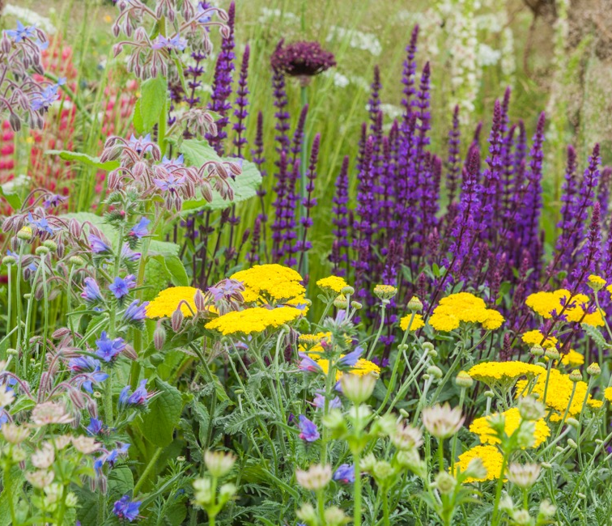
Other bees have medium-length tongues. This means that they are able to feed on lots of different flower shapes.
It can take time for bees to learn how to get to nectar from more complicated flower shapes, such as trumpet-shaped flowers.
When you think about which plants to grow, it is a good idea to have lots of different flower shapes available. This means there will be nectar available for many different types of bees.
A variety of flowers including spike and umbrella shapes.

Slide 3
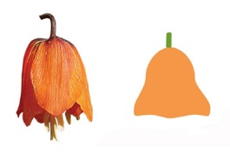
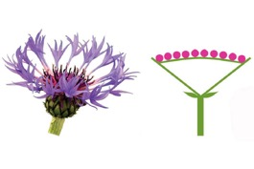
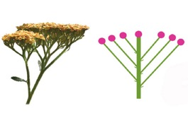
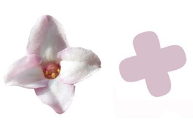
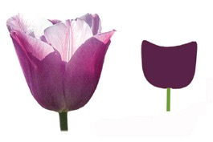
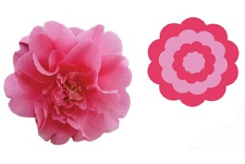
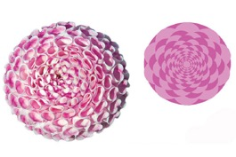
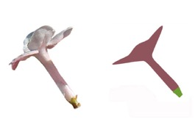
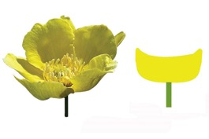
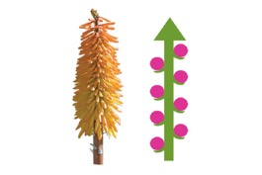
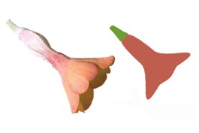
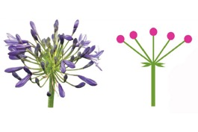
Learning activity: become a flower spotter.
1
2
3
4
5
Use the guide to see which flower shapes are growing outside.
How many different shapes can you find?
bell
capitulatum
cluster
corymb
cruciform
6
7
8
9
10
cup
double
pompom
raceme
salverform
11
12
13
14
15
16
saucer
solitary
spike
stellate
trumpet
umbel

Slide 4
Nectar Sweet liquid, produced in flowers.
Home |

Slide 5
Evolved To have changed over time in order to be able to survive more successfully.
Home |

