Slide 1
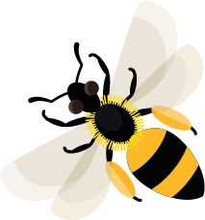
March
This month, hairy-footed flower bees are starting to feed on nectar to give them energy to have their young.
Learn about: what we can do now to help bees in June.
Why is June a difficult month for bees?
In June, early spring flowers have finished and are starting to go to seed, but summer blooms are not yet flowering.
This means that there are a few weeks when it can be hard for pollinators to find enough flowers with nectar and pollen to feed themselves and their young. This is known as the June pollen gap.
Flowers providing nectar and pollen in June

Slide 2
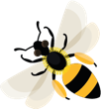
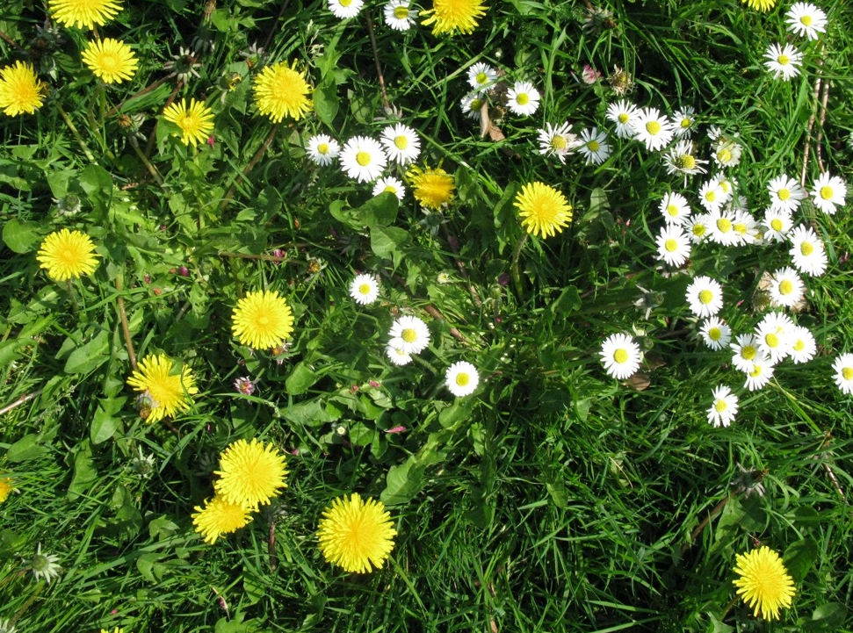
How can we help?
Make sure some patches of grass are left to grow long. These are likely to have dandelions and daisies flowering in June, which are brilliant sources of nectar and pollen.
Common poppy, common marigold and geranium seeds can be sown in March for pollen in June.
Talk to your teacher to see what’s possible.
Grass with dandelion and daisy flowers

Slide 3
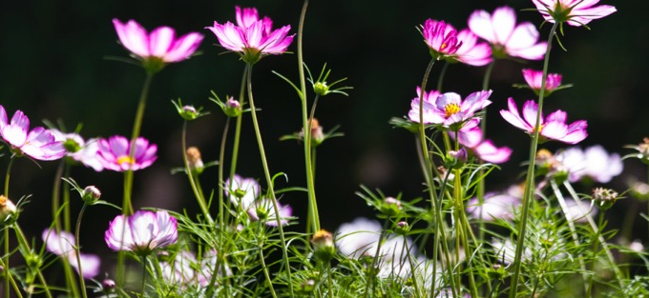
Learning activity: how can we help?
You need to get sowing in March if you want flowers for bees in June.
Think about asking the people in your school community (for example parents and carers) if they might have some spare flowering plant seeds which they could donate.
Check the back of any seed packets to find out when the seeds need to be sown to flower in June.
Flower seeds can be planted anywhere: recycled pots, window boxes and raised beds.
Hardy annual seeds can be sown outside in March e.g. poppies and cornflowers.
Cosmos flower seeds can be sown in March to flower in June
Newspaper containers used for sowing seeds

Slide 4
Nectar Sweet liquid produced in flowers.
Home |

Slide 5
Sown When a seed has been placed in soil or compost.
Home |

Slide 6
Sowing Placing a seed in soil or compost.
Home |

Slide 7
Pollinators Animals that move pollen from one flower or plant to another e.g. bees.
Home |

Slide 8
Pollen Dust-like grains, produced by the male parts of the flower.
Home |

