Slide 1
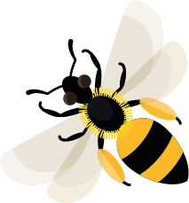
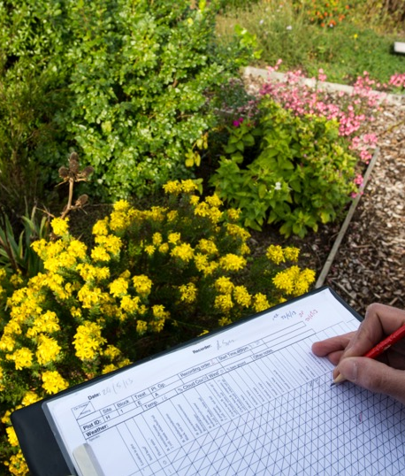
June
This month, early bumblebees are collecting nectar and pollen for their young.
Learn about: how bees are counted and why bee numbers matter.
What counting bees tells us
Counting bees helps us to estimate the total number of bees there are. This is important because it helps us understand where bees are and whether their numbers are going up or down.
Counting bees by looking
Scientists count the number of bees visiting an area over time and record the number of bees they see. They compare this to the number of bees counted in other areas and at different times of year.
Entomologists can use sweep nets to catch and identify different types of bees.
Scientists have to be very careful to make sure they don’t get stung and that they don’t hurt the bee while getting a closer look.
Counting bees and other insects

Slide 2
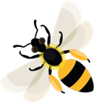
Learning activity:
watch the video to answer
these questions
s
People can also count bees using a device called a Polly, which listens to the sound that bees make and uses this information to work out how many there are nearby.
Watch the video to answer these questions:
What percentage of food crops depends on insects?
Which part of insects' bodies makes the sounds that the Polly detects?
How could scientists use the information collected?
How could farmers use the information collected?
Watch Polly inventor Casey Woodward talk about tracking pollinators.
Check your answers on the next slide.

Slide 3
Home |
Answers
What percentage of food crops depends on insects? Answer: 75%
Which part of insects' bodies makes the sounds that the Polly detects? Answer: Wings
How could scientists use the information collected? Answer: To understand where bees are dying out and where to target help.
How could farmers use the information collected? Answers might include: understanding where they might need to plant flowers, or allow flowers to grow, in order to encourage pollinators to visit their crops.

Slide 4
Entomologists Scientists who study insects.
Home |

Slide 5
Sweep net A special net which is swept over plants to collect insects (and other invertebrates, for example spiders) so that they can be studied by scientists.
Home |

