Slide 1
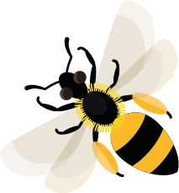
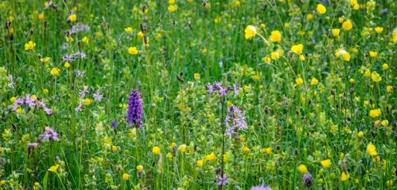
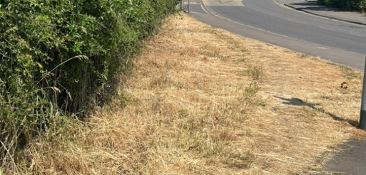
July
.
This month, white-tailed bumblebee males are looking for new queens as mates.
Learn about: how we can help bees.
We can make a difference. Our actions can make change happen.
The number of bees and other pollinating insects is declining. Here are some of the reasons why:
Environmental change is killing bees due to:
Loss of habitat and nesting sites.
Not enough flowering plants for bees to feed on. There are fewer flower-rich verges, hedgerows and wildflower meadows than there were in the past. The remaining ones are often small and in poor condition. Bees find it difficult to fly the long distances between the remaining habitat patches to find, food, nest and breed.
Wildflower meadow
Continued on the next slide.
Roadside verge without flowers

Slide 2
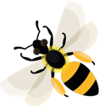
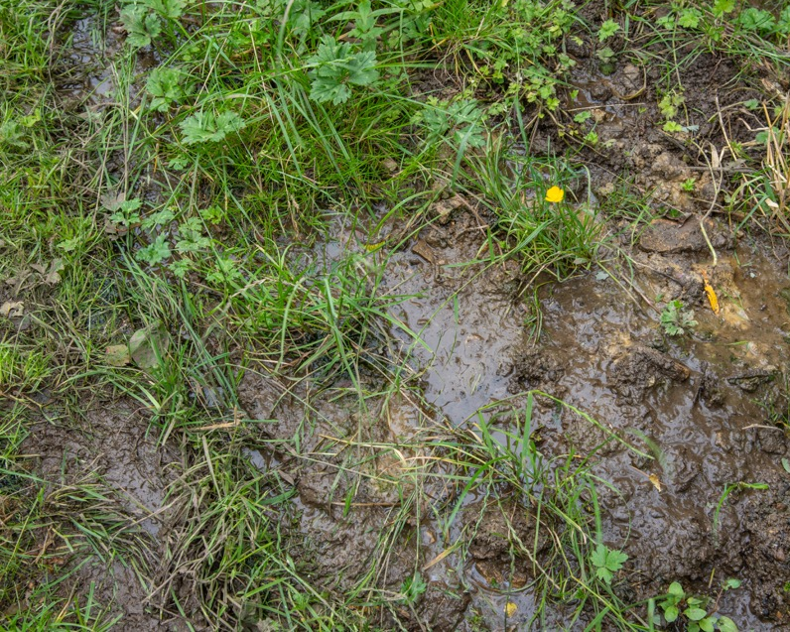
Climate change is causing weather and temperatures around the world to change. This means it may be too hot or too wet for some species of bee to survive.
The use of pesticide chemicals to kill insects that damage plants. These chemicals also kill or injure bees and other pollinating insects.
Humans are causing environmental change
Bee numbers are going down because human actions are causing changes to the environment, and this is making it difficult for bees to survive. Habitat loss, lack of food, climate change and pesticide use are all related to human activity. Our actions can either harm or help bees.
Heavy rain in the summer can mean it is too wet for bees to fly and their nests may be flooded.

Slide 3
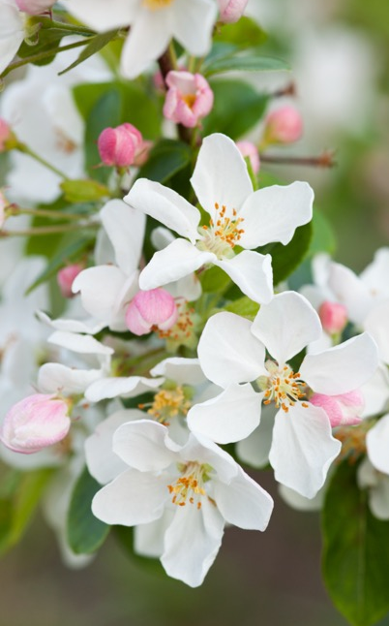
Learning activity: how can we help bees? There are lots of things we can do to help bees. Click the web links below to find out how:
Grow flowers for bees: Flower Power
Grow trees and shrubs for bees: Trees and shrubs
Provide water for pollinators: Water
Provide nesting places for bees: Providing shelter
Water dish with pebbles so pollinators can safely drink
Apple tree blossom providing nectar and pollen

Slide 4
Verges Narrow areas beside roads where grass and flowers grow.
Home |

Slide 5
Wildflower meadows Fields where grass and wildflowers grow.
Home |

Slide 6
Mates Partners of the opposite sex to breed with.
Home |

Slide 7
Environment The surroundings in which anything living is found.
Home |

Slide 8
Blossom A flower or lots of flowers usually on a tree or bush.
Home |

