Slide 1
LO: To create and explore a range of sounds ​using natural materials and the inter-related ​dimensions of music

Slide 2
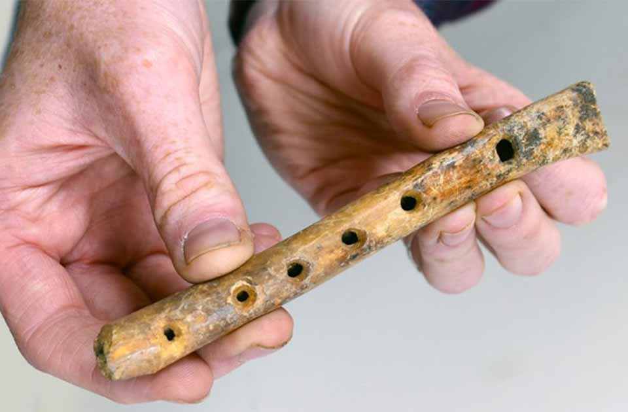
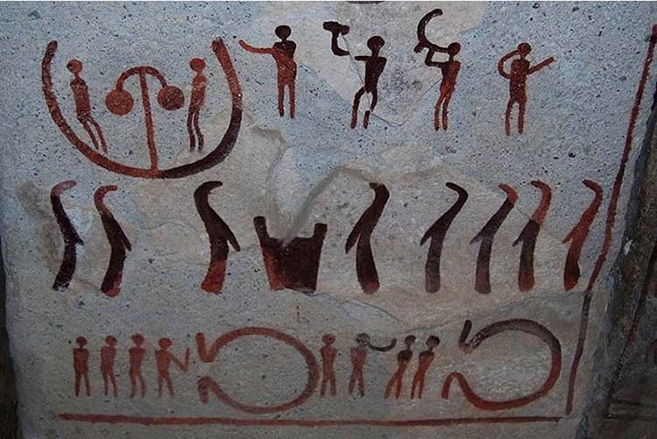
Why do you think people ​have always been drawn to creating music?
If you had to create music using only natural materials, what might you consider using? Why?

Slide 3
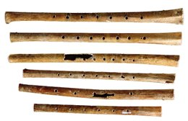
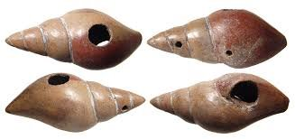
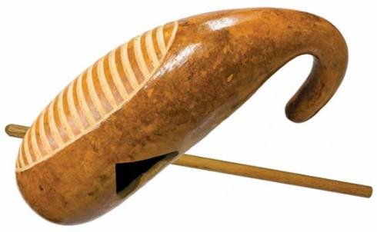
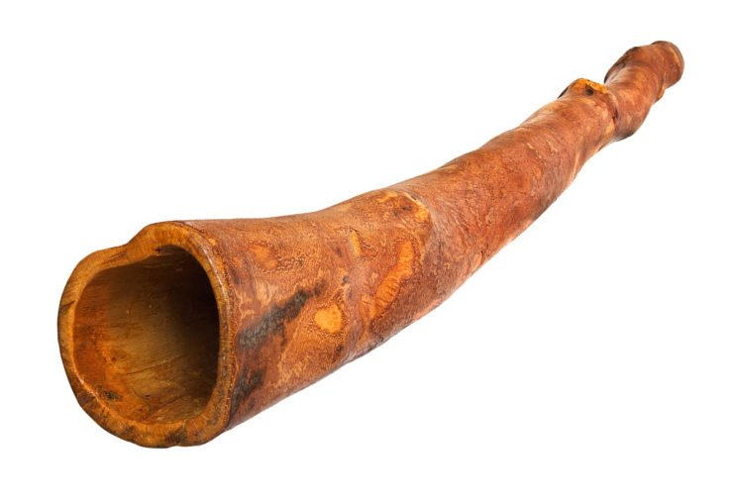
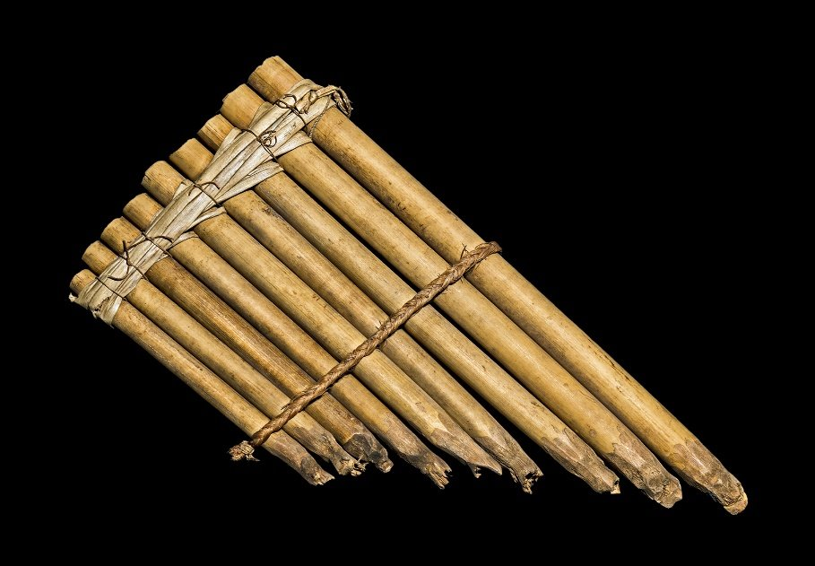
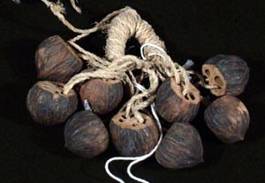
Early Musical Instruments
​ Animal bones and horns​ ​ | Shells​ ​ | Gourds​ ​
Bamboo​ ​ | Wood​ ​ | Seeds and Seed Pods​ ​

Slide 4
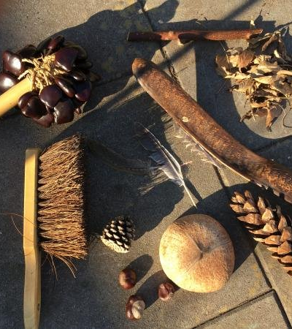
Let’s create a ​
Garden Orchestra
Explore the range of sounds you can make using natural materials found outside.
National Curriculum Links
KS1: experiment with, create, select and combine sounds using the inter-related dimensions of music
KS2: improvise and compose music for a range of purposes using the inter-related dimensions of music.
KS3: use the interrelated dimensions of music expressively

