Slide 1
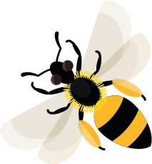
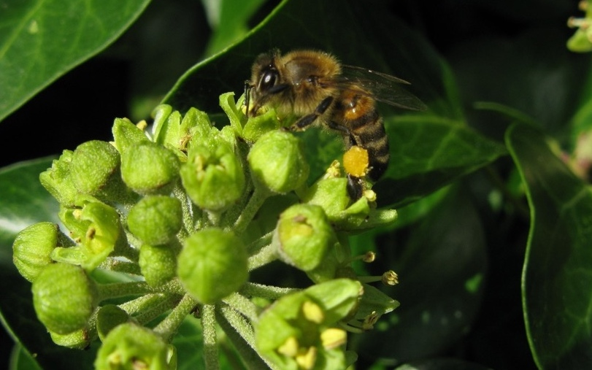
December
This month most bees are avoiding the cold, hibernating in nests.
Learn about: how many types
of bees there are in the UK.
There are over 270 different types of bee in the UK. Some of these bees are solitary and raise young on their own, while others are social and work together to raise young.
Over 250 types are solitary bees. Most are only active during spring and summer but the ivy bee can be spotted well into autumn visiting ivy flowers to collect pollen. Other examples of solitary bees are red mason bees, wool carder bees and leaf-cutter bees.
Honeybee on ivy flower

Slide 2
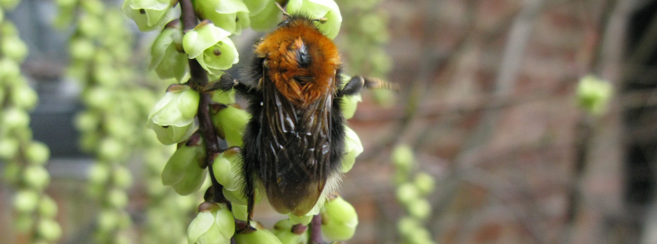
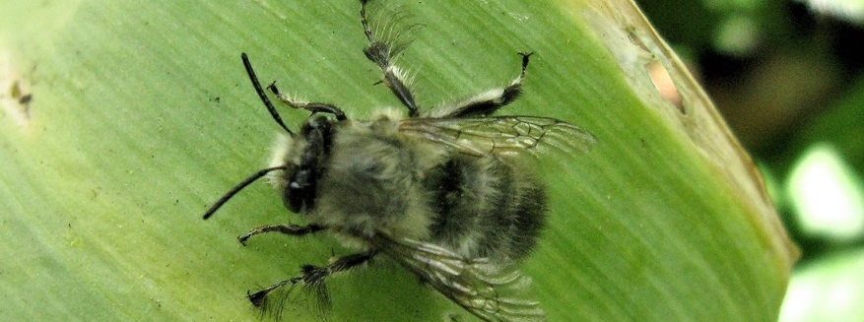
Most bumblebees and honeybees are social bees. Bumblebees are large and furry and make a deep buzzing sound when they fly. They can be black, red, orange, white, cream and yellow and are often stripey. There are 24 different types of bumblebee in the UK and most live in wild colonies.
There is only one type of honeybee in the UK. Most honeybees live in a hive where they are looked after by a beekeeper. Honeybees are smaller and less furry than bumblebees, they are mainly yellow and brown.
A tree bumblebee
Hairy-footed flower bee - one of the solitary bees

Slide 3
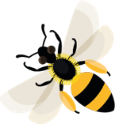
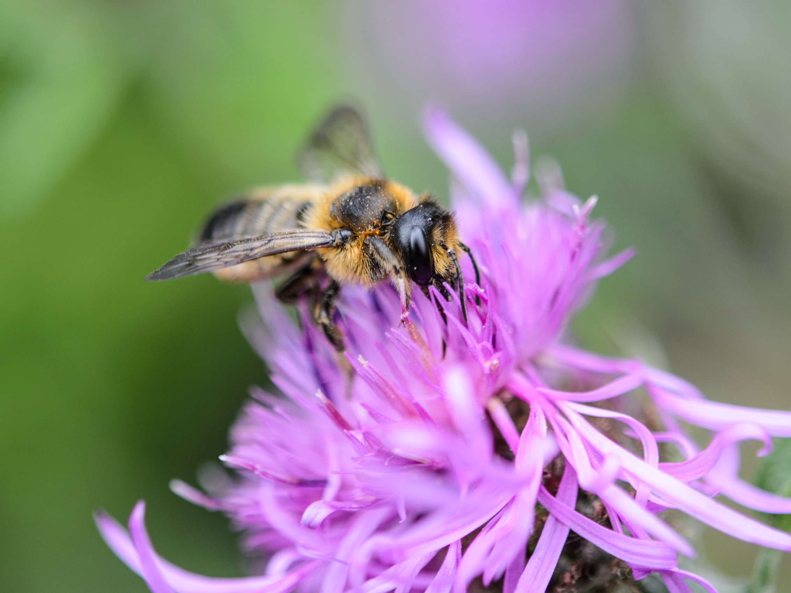
Learning activity: get together with a partner and see if you can find the answers to these questions.
Quiz
How many types of bee are there in the UK?
What are bees that work together to raise young called?
What colour are bumblebees?
How many types of bumblebee are there in the UK?
How many types of honeybee are there in the UK?
Answers
A leafcutter bee

Slide 4
Quiz answers 1. There are 270 different types of bees in the UK. 2. Bees that like to live with other bees are called social bees. 3. Black, red, orange, white, cream and yellow. 4. There are 24 types of bumblebee in the UK. 5. There is only one type of honeybee.
Home |

Slide 5
Pollen Dust-like grains, produced by the male parts of the flower.
Home |

Slide 6
Colonies Large groups of one type of animal that are living and working together. Social bees lives in colonies, including honeybees and most bumblebees. Honeybee colonies are given the specific term ‘hive’ or ‘beehive’.
Home |

Slide 7
Hive A structure where honeybees live and raise their young.
Home |

