Slide 1
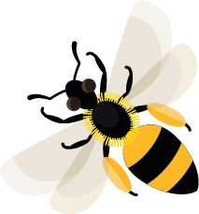
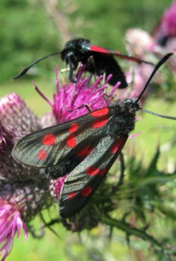
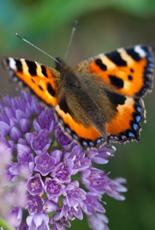
August
This month, common yellow-face bees will be nesting in hollow stems.
Learn about: pollinators
Some plants are pollinated by wind, but most are pollinated by insects.
Bees are excellent pollinators, but they are not the only insect pollinators in the UK. There are actually 1,500 pollinating insect species, including wasps, butterflies, moths, beetles and flies.
On the next slide we will be looking at some of them.
Six-spot burnet moth
Small tortoiseshell butterfly

Slide 2
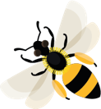
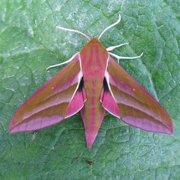
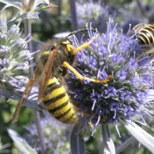
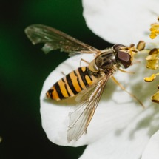
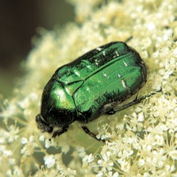
Pollinating insects living in the UK
Moths:
Wasps:
Elephant hawk moth
Many types of moth fly at night so we may not see them but they are important pollinators. They use their long tongues to feed on nectar in flowers. As they do this, pollen sticks to their furry bodies, and brushes onto the next flower they visit, which could be many kilometres away.
Social wasps
When wasps visit flowers to feed on nectar, they don’t pick up as much pollen as bees. This is because their bodies have less hair for pollen to stick to, but they are still valuable pollinators.
Hoverflies:
Beetles:
Marmalade hoverfly
Most adult hoverflies feed on nectar, some types also eat pollen. They prefer flat flowers which they can easily land and feed on. Despite their small size, it is thought that up to 4 billion hoverflies migrate to Britain each year!
Rose chafer beetle
Many types of beetle visit flowers to eat pollen. While they are feeding, some pollen sticks to their bodies. This pollen brushes off when they visit the next flower, meaning pollination can take place.

Slide 3
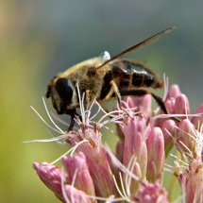
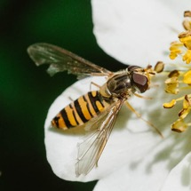
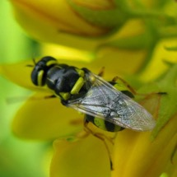
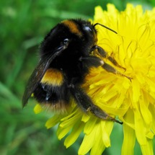
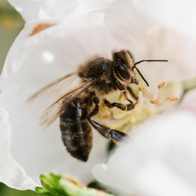
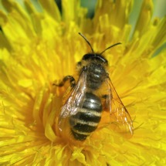
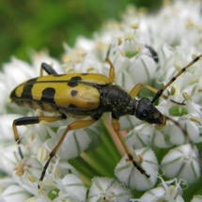
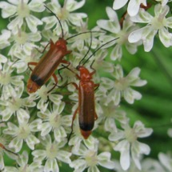
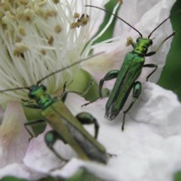
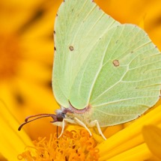
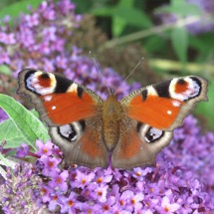
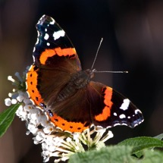
1
2
3
4
Learning activity:
why not get outside and have a look for pollinating insects?
Find a patch of flowers in some sunshine and wait quietly to see what turns up.
You can use the pollinating insect spotter guide to help you to identify what you see.
Drone fly
Marmalade hoverfly
Soldier fly
Bumblebee
5
6
7
8
Honey bee
Solitary bee
Longhorn beetle
Soldier beetle
9
10
11
12
Remember just to look
and not to touch.
Thick-legged flower beetle
Brimstone butterfly
Peacock butterfly
Red admiral butterfly

Slide 4
Pollen Dust-like grains, produced by the male parts of flowers.
Home |

Slide 5
Pollination When a flower or plant has received pollen which has resulted in the flower or plant being able to make seeds.
Home |

Slide 6
Pollinators Animals that move pollen from one flower or plant to another e.g. bees.
Home |

Slide 7
Nectar Sweet liquid, mainly produced in flowers.
Home |

